Slide 1
Climate Change & Global Warming
NAME :- RAVI RANJAN KUMAR & SHIVANI CHOUDHARY
COURSES :- BSC(HONS) PHYSICS & COMPUTER SCIENCE
COLLEGE ROLL NO. :- 26213 & 25806
UNIVERSITY ROLL NO. :- 24035567021 & 24035570046
VAC :- SCIENCE AND SOCIETY (2025-26)

Slide 2
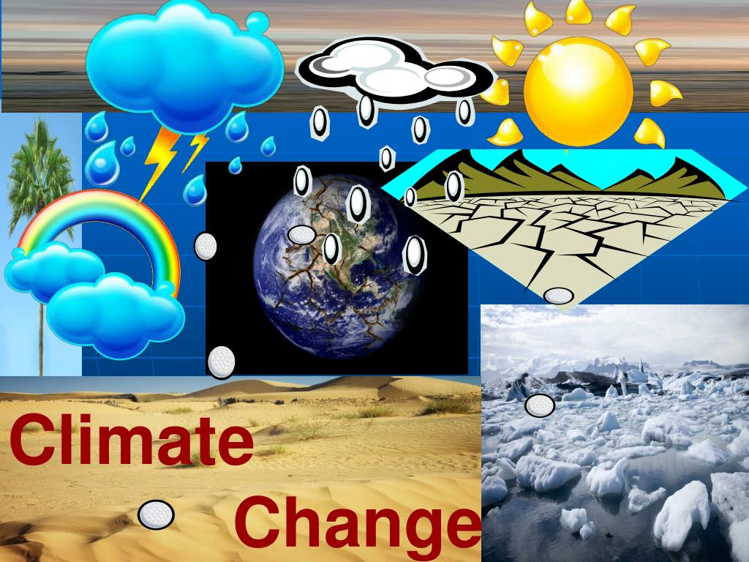
Introduction
Climate change refers to long-term changes in temperature and weather patterns.
Global warming is the long-term increase in Earth’s average surface temperature.

Slide 3
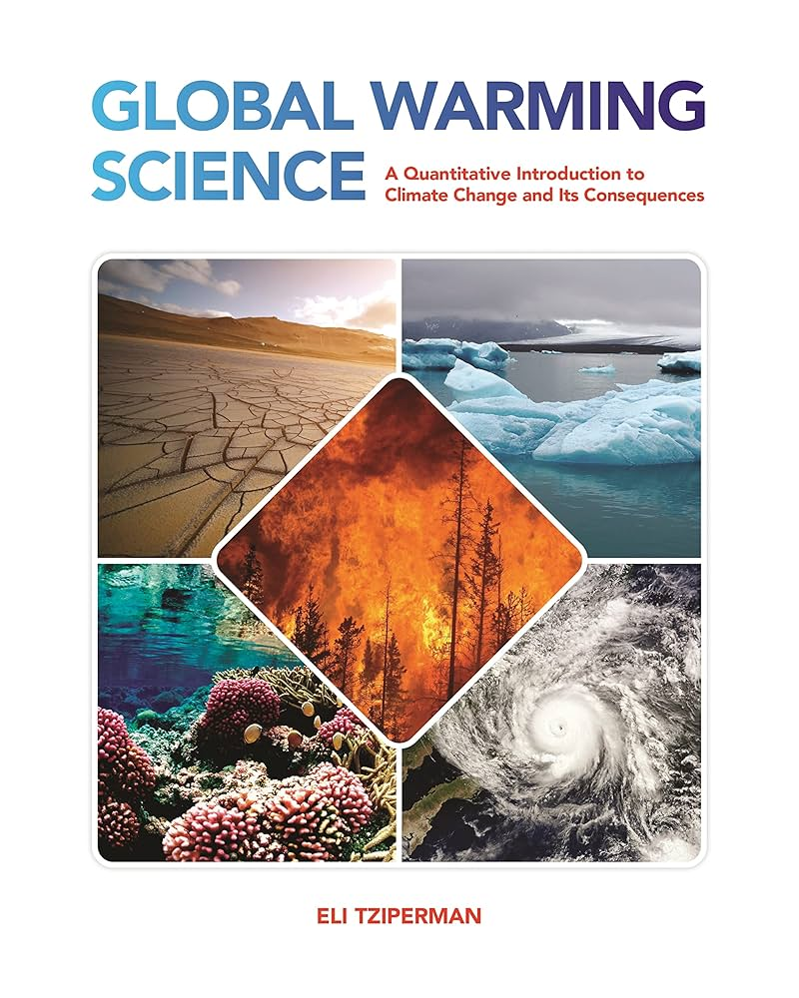
Climate Change vs Global Warming
Global warming is one aspect of climate change.
Climate change includes rising sea levels, extreme weather, and ecosystem changes.

Slide 4
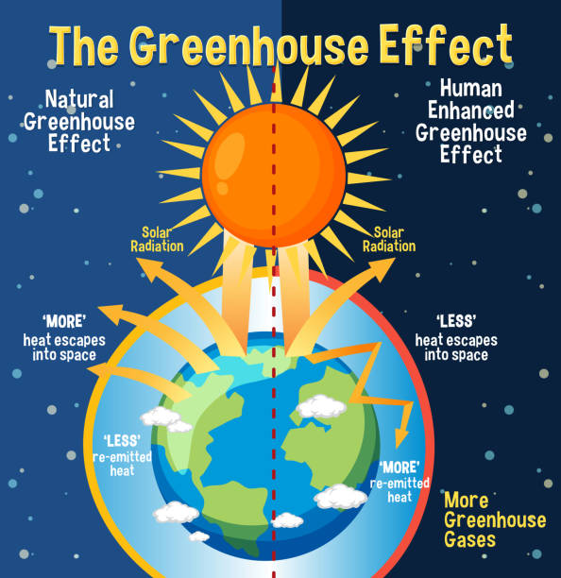
Greenhouse Effect
Greenhouse gases trap heat in Earth’s atmosphere.
This natural process becomes harmful when intensified by human activities.

Slide 5
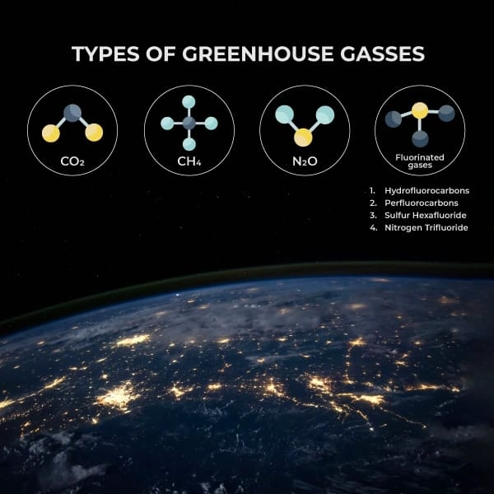
Major Greenhouse Gases
Carbon dioxide (CO₂)
Methane (CH₄)
Nitrous oxide (N₂O)
Chlorofluorocarbons (CFCs)

Slide 6
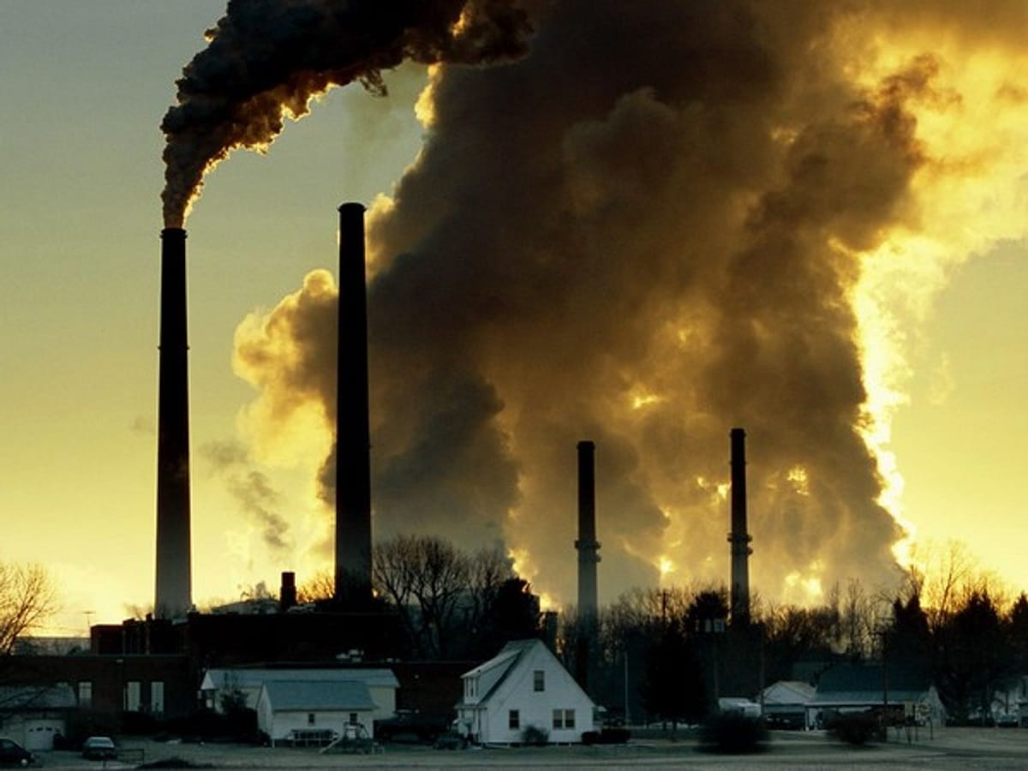
Causes of Global Warming
Burning of fossil fuels
Deforestation
Industrialization
Urbanization

Slide 7
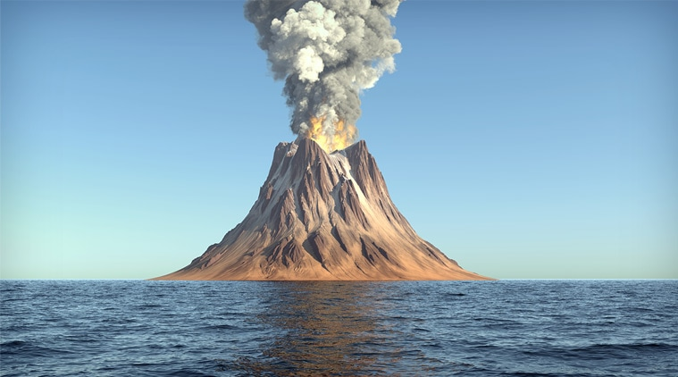
Natural Causes
Volcanic eruptions
Solar radiation variations
Ocean current changes

Slide 8
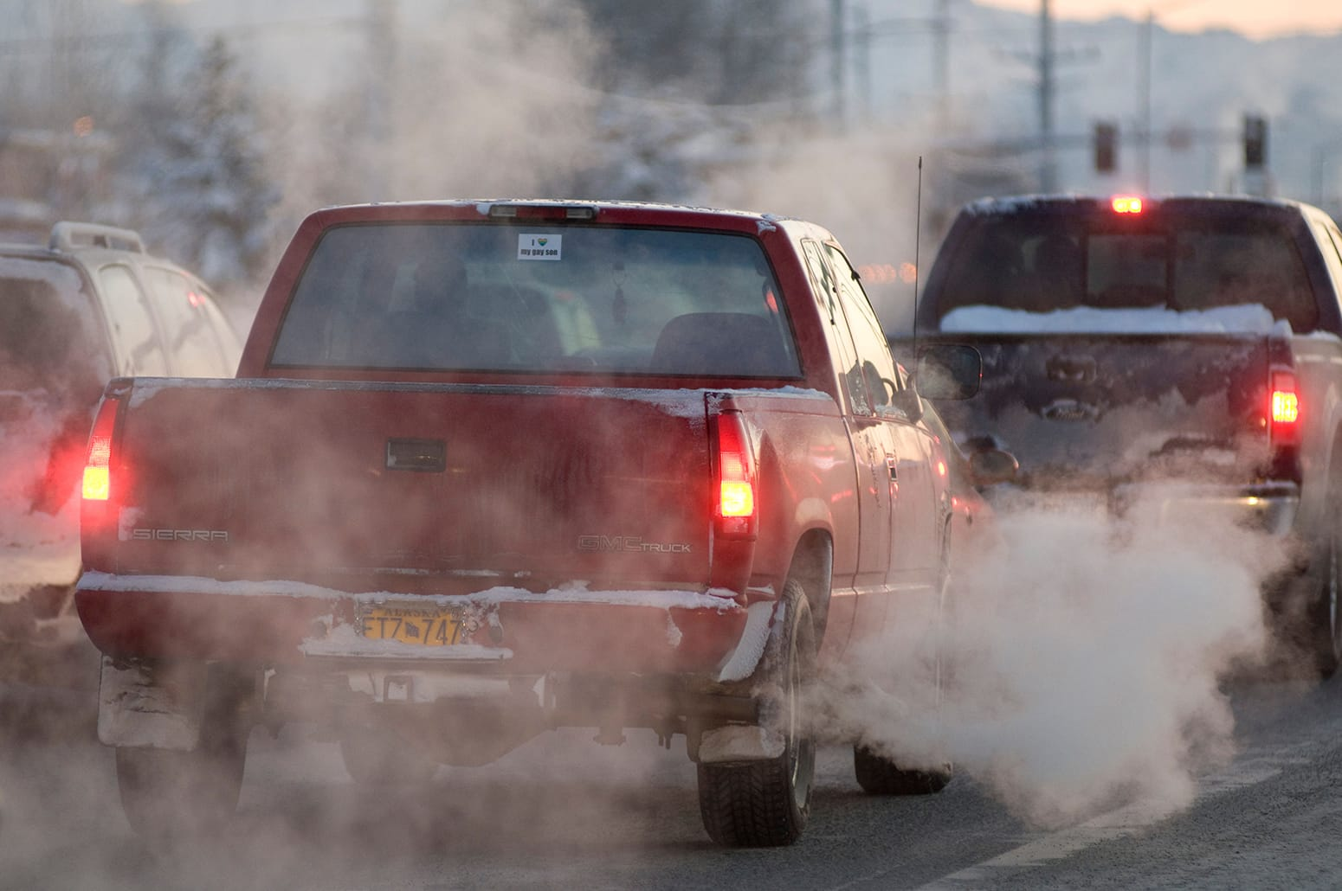
Human Activities
Use of coal and petroleum
Vehicle emissions
Deforestation for agriculture

Slide 9
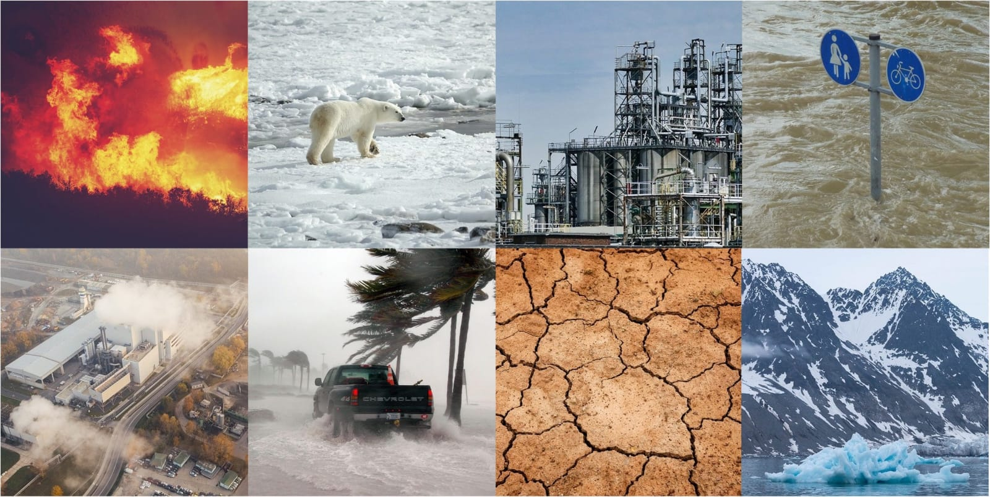
Environmental Impacts
Melting of glaciers
Rising sea levels
Loss of biodiversity

Slide 10
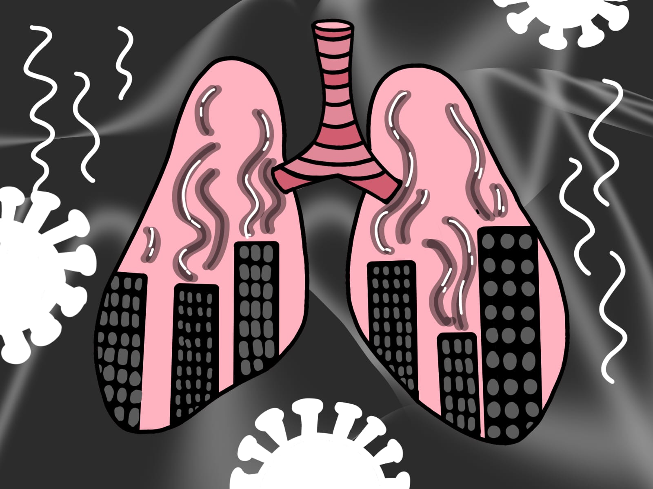
Impact on Human Health
Heat strokes
Respiratory diseases
Spread of infectious diseases

Slide 11
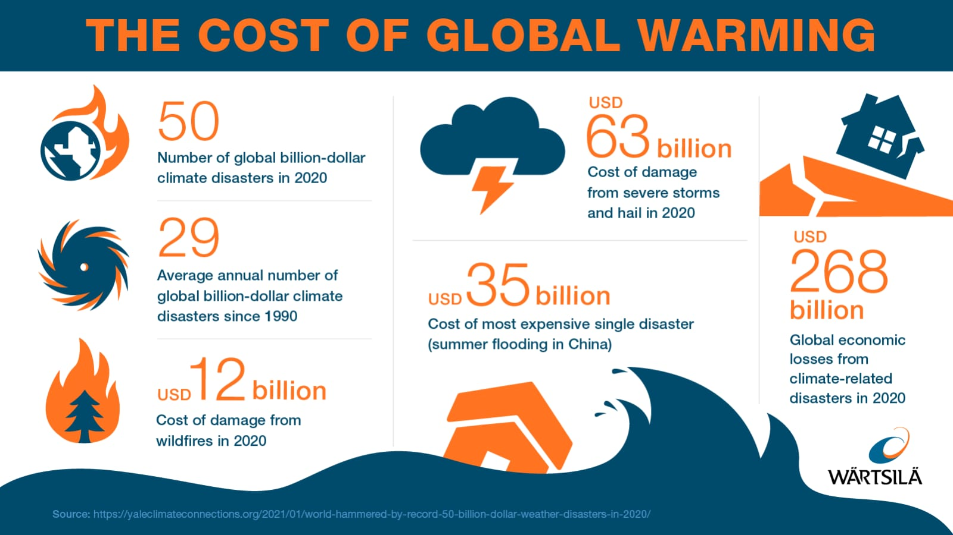
Economic Impacts
Damage to crops
Loss of livelihood
Increased disaster management cost

Slide 12
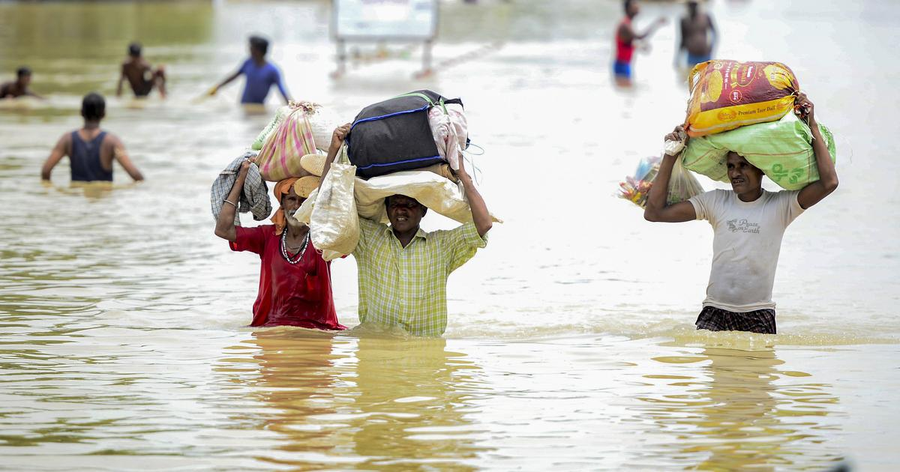
Climate Change in India
Erratic monsoons
Heat waves
Floods and droughts

Slide 13
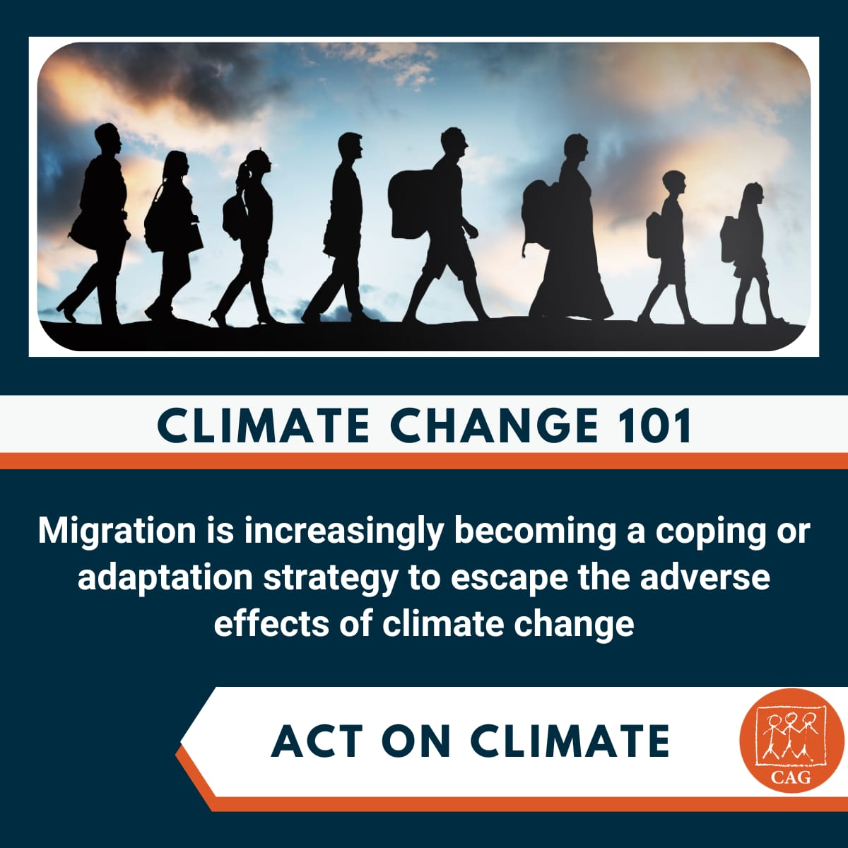
Mitigation Strategies
Use of renewable energy
Afforestation
Energy efficiency

Slide 14
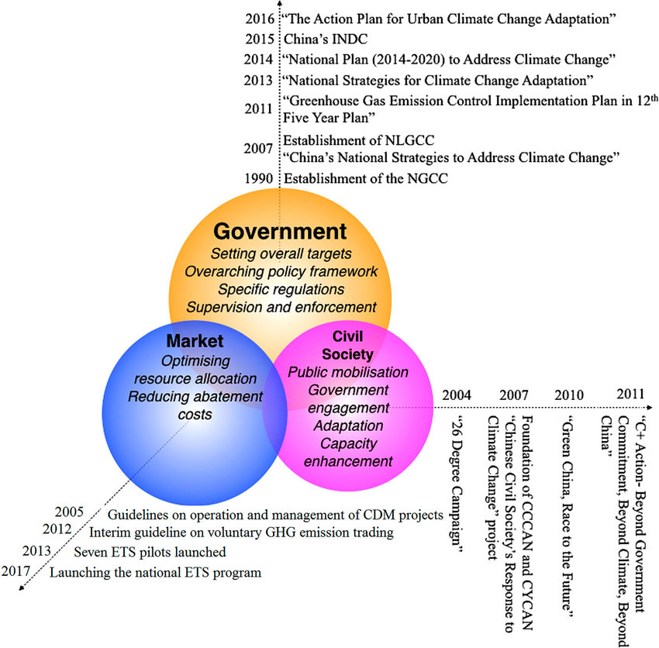
Role of Government & Individuals
Government policies and agreements
Public awareness
Sustainable lifestyle

Slide 15
Q 1. Global warming and climate change are two major concerns in modern times. Explain how science and technology are trying to address these two issues.
Renewable Energy Technologies – Science has developed solar panels, wind turbines, and hydroelectric power to reduce dependence on fossil fuels and lower greenhouse gas emissions.
Energy-Efficient Systems – Technology promotes LED lighting, energy-efficient appliances, and smart grids to reduce energy consumption and wastage.
Electric and Hybrid Vehicles – Development of electric cars, buses, and trains helps reduce carbon dioxide emissions from transportation.
Climate Monitoring & Satellites – Satellites and sensors are used to monitor temperature rise, melting glaciers, sea-level rise, and weather patterns accurately.
Carbon Capture and Storage (CCS) – Scientific methods are being developed to capture carbon dioxide from industries and store it underground to prevent its release into the atmosphere.

Slide 16
Afforestation & Biotechnology – Technology helps in large-scale tree plantation, genetically improved crops, and forests that absorb more CO₂.
Waste Management Technologies – Recycling, waste-to-energy plants, and biodegradable materials help reduce pollution and greenhouse gases.
Climate Modeling & Prediction – Advanced computer models predict future climate changes, helping governments plan preventive measures.
Sustainable Agriculture – Science promotes organic farming, drip irrigation, and climate-resilient crops to reduce environmental impact.
Public Awareness & Digital Tools – Technology like mobile apps, online platforms, and media spreads awareness about climate change and promotes eco-friendly lifestyles.

Slide 17
Q 2. Global warming is one of the major causes of climate change in modern era. Write a short note highlighting the following : a) how has global warming affected weather condition in india ? b) how can this problem be addressed ?
a)
Increase in average temperatures leading to frequent heat waves.
Irregular and unpredictable monsoon rainfall patterns.
More extreme weather events like floods, droughts, and cyclones.
Melting of Himalayan glaciers affecting river flow and water supply.
Rising sea levels causing coastal erosion and flooding in coastal areas.
Negative impact on agriculture due to changing seasons and rainfall.

Slide 18
b)
Reduce greenhouse gas emissions by using renewable energy sources.
Promote afforestation and prevent deforestation.
Use public transport and eco-friendly vehicles to reduce pollution.
Conserve energy and adopt energy-efficient technologies.
Spread awareness about climate change and sustainable practices.
Implement strict environmental laws and international cooperation.

Slide 19
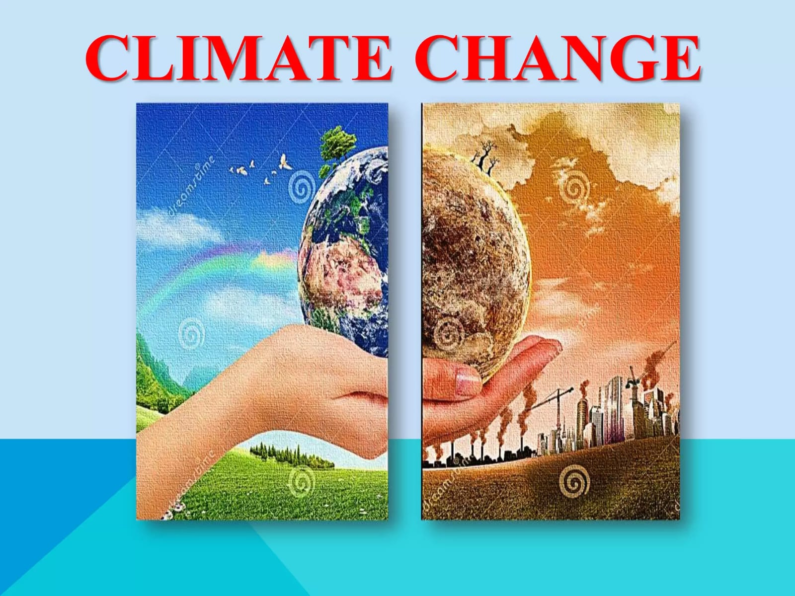
Conclusion
Climate change is a global challenge.
Immediate collective action is required.

